Slide 1
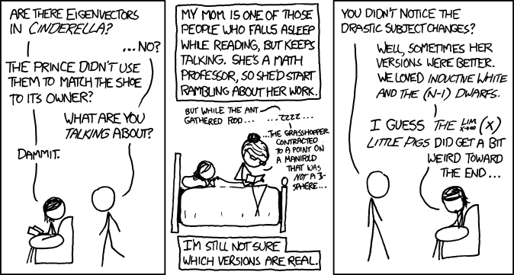
xkcd
Xkcd.com

Slide 2
Section 3 Recap
Angular momentum commutators:
[J_{x}, J_{y}] = iħJ_{z} etc
Total ang. Mom. Operator: J ²= J_{x}²+ J_{y}² +J_{z}²
Ladder operators:
J₊ = J_{x} + i J_{y} , J₊| j, m⟩ = c₊( j, m) | j, m +1⟩ (=0 if m = j)
J₋ = J_{x} − i J_{y} , J₋| j, m⟩ = c₋( j, m) | j, m −1⟩ (=0 if m = −j)
c ±( j, m) = √[ j (j +1)−m (m ±1)]ħ
Eigenvalues
J ²: j ( j +1)ħ ², j integer or half-integer
J_{z}: m ħ, (−j ≤ m ≤ j ) in steps of 1
Matrix elements: raising (lowering) only non-zero on upper (lower) off-diagonal
Eigenvector ordering convention for angular momentum: First eigenvector is largest angular momentum (m = j ).

Slide 3
Section 3 Recap
Direct products
Of vector spaces, of the vectors in them, of operators operating on them
Operator on first space (A₁) corresponds to A₁⊗I on direct product space.
Orbital angular momentum acts on (θ,φ), factor space of 3-D space (r, θ, φ ).
Extra constraint on total angular momentum quantum number ℓ: integer, not half-integer
Spin angular momentum acts on its own vector space, independent of 3-D wave function.
Fundamental particles have definite total spin S ²: never changes.
Spin-half: 2-D vector space:
Spin in any one direction is superposition of spin up & spin down along any other direction
Every superposition corresponds to definite spin in some direction or other.
Pauli spin matrices (Neat algebraic properties)

Slide 4
Section 3 Recap
2π rotation of spin-half particle reverses sign of wave function: need 4π rotation to get back to original.
Magnetic resonance example (Rabi precession): spin precession in a fixed field, modulated by rotating field.
Addition of angular momentum
Work in direct product space of components being summed
J = |j₁+j₂| to |j₁−j₂|
Triplet and singlet states (sum of two spin-halfs)
Find Clebsch-Gordan coefficients: amplitude of total angular momentum eigenstates |J, M ⟩ in terms of the simple direct products of component ang. mom. states, |j₁,m₁ ⟩|j₂,m₂ ⟩:
CG Coeffs = 0 unless M = m₁+m₂
Stretched states:

Slide 5
Section 4 Recap
Functions as vectors in “function space”
Infinite-dimensional in most cases
Many ∞-D spaces, for different classes of functions
1, 2 3 or more coordinates
Continuous or allowed jumps
Normalizable, i.e. square integrable (L²) or not…
Overlap integral is inner product:
where f_{i} , g_{i} are amplitudes of Fourier components of f & g.
Discontinuous functions require fussy treatment
Don’t represent physically possible wave functions.
Operators with continuous eigenvalues have unnormalizable eigenfunctions (delta functions, fourier components)
Not physically observable but mathematically convenient.

Slide 6
Recap 4 continued
Domain of operator: D(A) is subspace of vectors |v⟩ for which A|v⟩ is in original space
For operator A with continuous eigenvalues
Completeness relation/diagonalised form of operator.

Slide 7
Recap 4
Position operator x :
In position representation, multiply wave function by x
Eigenfunctions (unphysical) are Dirac delta-functions.
Best considered as bras, not kets:
⟨x |ψ⟩ = ψ(x)
Wavenumber operator K :
In position representation: -i d/dx.
Eigenfunctions in position representation are pure complex waves: e^{ikx}/√2π
In wavenumber representation: delta-functions.
Hermitian if wavefunction tends to zero at infinity (as do all normalizable functions).
Fourier transform is a unitary transform:
Change of basis from position to wavenumber basis
In QM, momentum p = ħK

Slide 8
Recap 5
Simple harmonic oscillator
H = p ²/ 2m + x ²(mω ²/ 2) = ħω(a†a + ½)
a = Ax + i B p for suitable A,B
a†a= N is number operator, eigenvalues 0,1,2,…
Total energy = (n + ½) ħω
a† = creation operator: adds a quantum
a = annihilation operator: removes a quantum
Operators for a†, a, x, p, H in energy/number basis represented by infinite matrices, non-zero only on the off-diagonals (linking states separated by one quantum).

Slide 9
Recap 5
Represent ⟨x |a|0⟩ = 0, or a† |n-1⟩ = √n |n ⟩, in position basis, then solve for eigenfunctions ⟨x |0⟩ = ψ₀(x), ⟨x |1⟩ = ψ₁(x) etc
Harmonic oscillator illustrates quantum-classical transition at high quantum number n. Truly classical behaviour (observable change with time) requires physical state to be a superposition of energy states.

Slide 10
Recap 6
Vector space of N-particle system is direct product of single-particle spaces.
States are separable if they can be written as a simple direct product
Most states are superpositions of simple direct products: Entanglement.
Entangled Bohm states (& similar) illustrate non-locality implied by wave-function collapse: violates Bell inequalities
Verified experimentally
Quantum Information Processing: based on qubits (two-level systems).
In principle can solve some problems exponentially faster than classical computers.
Not yet feasible due to decoherence: at most a handful of qubits operated successfully as a unit.
Quantum key distribution already viable technology: guaranteed detection of any evesdropper on exchange of cipher key.

