Slide 1
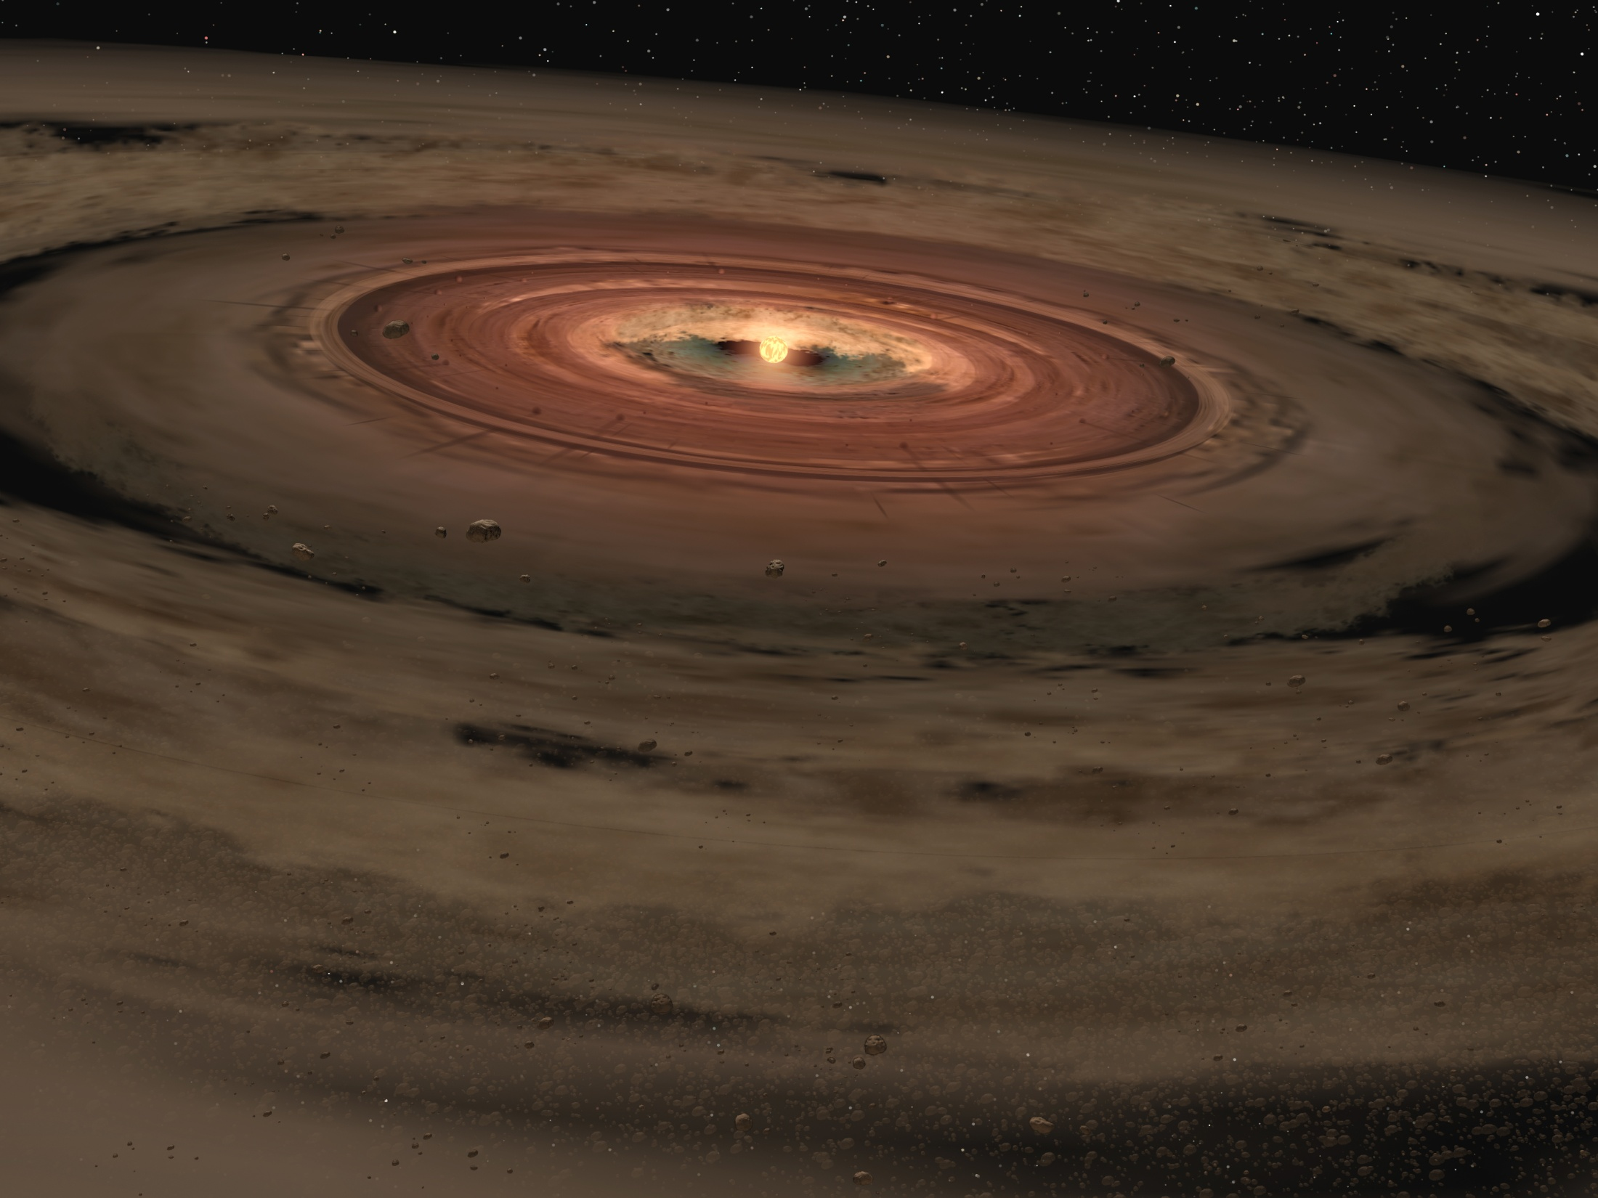
Using mm observations to constrain variations of dust properties
in circumstellar disks
Francesco Trotta
Advised by:
Leonardo Testi
YERAC, Manchester - 2011

Slide 2
Outline
Planet Formation in circumstellar disks
Observational evidence of dust grain growth
Constrain the radial variation of dust properties with high-resolution mm-observation
Future prospective with ALMA
1
2
3
4

Slide 3
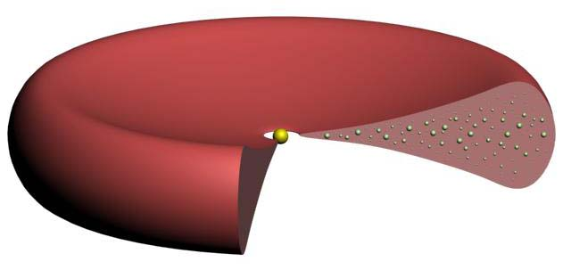
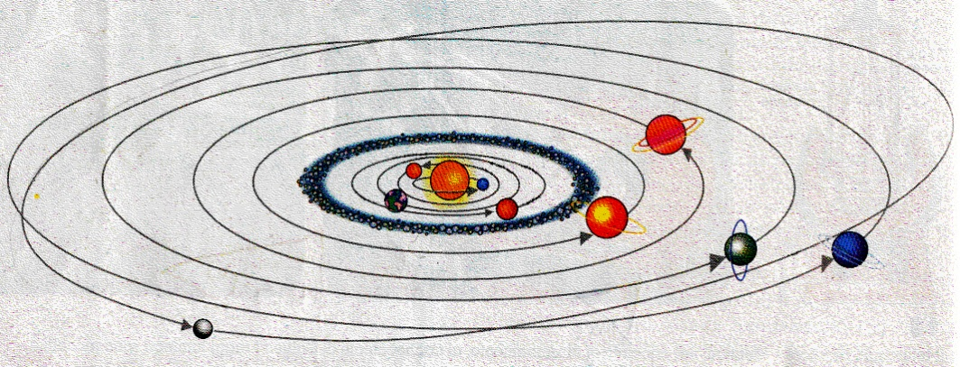
What are the circumstellar disks and why do we study them?
Mass
accretion
Angular Momentum
transported outward
dominates the mass
→the dynamics of the disk
Rotating disk
GAS
99%
dominates the opacity
→ thermal and gemetrical structure of the disk
→the emission properties of the disk
DUST
1%
Forming star
Circumstellar disks play a fundamental role in the process of star and planet formation
Central forming star accretes most of its mass throught the disk
Turbulence
Transport angular momentum
Mass accretion onto the star
with time: (1) M_{star}↗ M_{disk}↘ (2) Disk spreads out
Disks are presumed to be the birthplace of planetary system

Slide 4

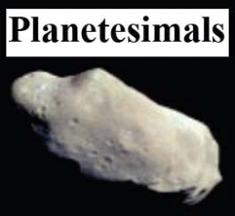




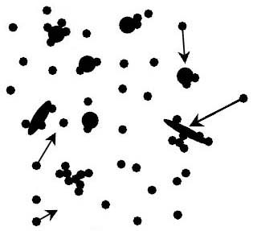
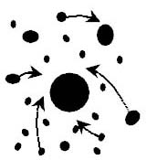
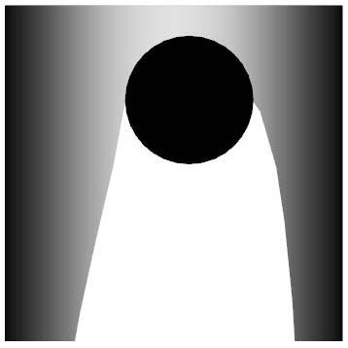
From dust to planet
Growth of 12 order of magn. in size in a few Myr
ISM
dust
grains
1μm
1mm
1m
1km
10³km
Log a
coupled to the gas
gravity
coupled to the gas + gravity
well
weak
Early growth
Mid-life growth
Late growth
Aereodynamic interaction
Gravitational interaction
Gas sweeping
Core accretion
model

Slide 5
From dust to planet
Growth of 12 order of magn. in size in a few Myr
ISM
dust
grains
Directly observable
Exo-Planets
1μm
1mm
1m
1km
10³km
Log a
coupled to the gas
gravity
coupled to the gas + gravity
well
weak
Early growth
Mid-life growth
Late growth
Aereodynamic interaction
Gravitational interaction
Gas sweeping
Core accretion
model

Slide 6
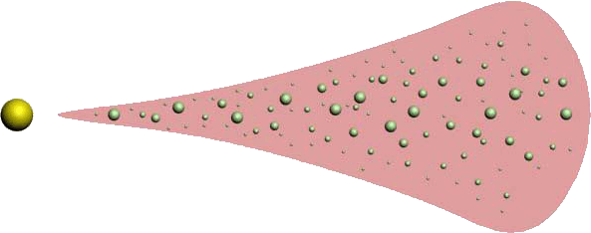
Which observations do we need?
The dust thermal emission (at each radius)
Optical
depth
with
LIMITATION:
Optical depth is very high (at least at short λ)

Slide 7
Which observations do we need?
The dust thermal emission (at each radius)
Optical
depth
with
LIMITATION:
Optical depth is very high (at least at short λ)
V
Information only on grain located in the surface layer (tiny fraction of dust mass)
IR
Longer λ, bigger fraction of the dust optically thin
R
Probe the bulk of the dust mass in the disk mid-plane
Limited to the outer regions of the disks

Slide 8

How to observe dust grain size at mm-λ?
For a optically thin disk and in RJ regime the dust thermal emission at mm-λ
We are observing β
(diagnostic of dust size,shape,composition)
Small (compact) grain (a<<λ)
(es. ISM dust β ~ 1.7)
β=2
F_{ν} ~ν⁴
mm-size particles
Draine & Lee (1984)
Log F
F_{ν} ~ν²
0<β<2
F_{ν} ~ ν^{2:4}
Solid bodies with a>>λ/2π
(es. Rocks)
β=0
Gray opacity
Log λ
Optically thick inner region
+
β > α - 2
Deviation from RJ regime

Slide 9
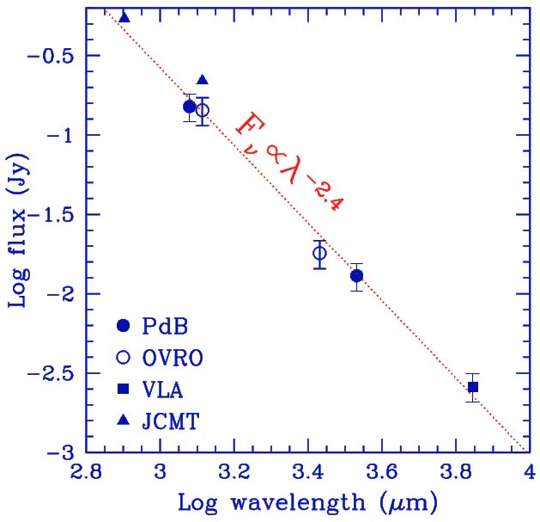
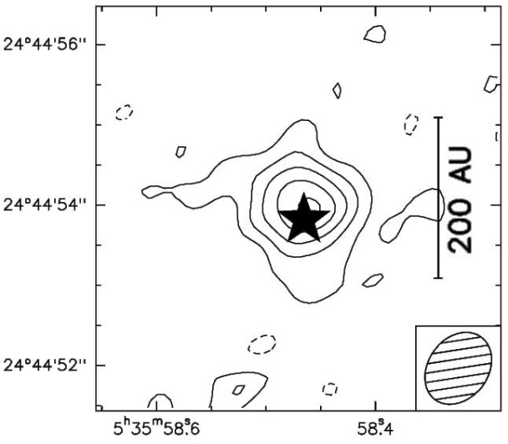
Grain growth evidence from mm spectral index
Testi & al. (2003)
Observational
evidence
Shallow SED
(α mesured are small )
CQ Tau
(1) Optically thin disk & low β
Two
possibility
(2) Optically thick disk & any β
VLA 7mm
res~0.8’’
(~100 AU)
Need of Spatially Resolved Disk at mm λ
(hi-res interferometry)
Resolved (large) disks make (2) improbable
If β < β_{ISM} ~ 1.7
DUST GRAIN
GROWTH

Slide 10
How to constrain the radial variation of dust properties?
Dust evolution models predict grain growth
→ different dust properties in function the position on the disk
κ_{dust}(x)
Disk models
(with radial variation of the grain size distrib)
We are trying tho constrain the radial opacity profile
High-resolution observ (at more λ)

Slide 11

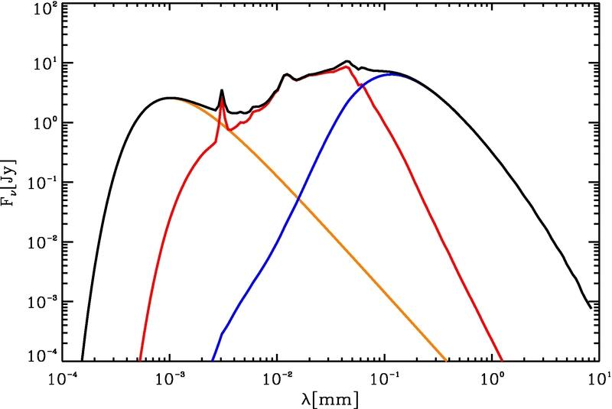
How to constrain the radial variation of dust properties?
Disk models
Surface Density
Similarity
Solution
Interior
Grain size distribution
PowerLaw
approximation
Surface layer
STAR
BB emission picco a λ - 1 μm (near-IR)
total
SURFACE LAYER
Dominate the flux ~ 60 μm (mid-IR)
surface
star
interior
INTERIOR LAYER
Dominate the flux a λ > 100 μm (sub-mm/mm)

Slide 12
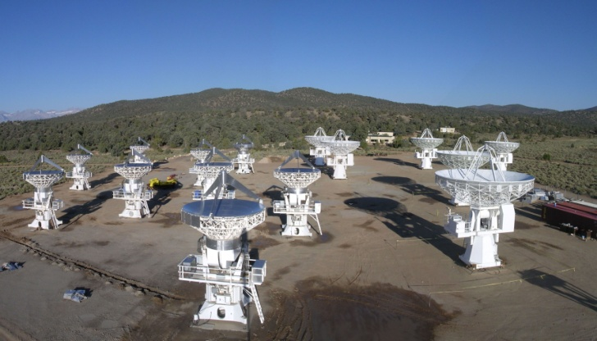
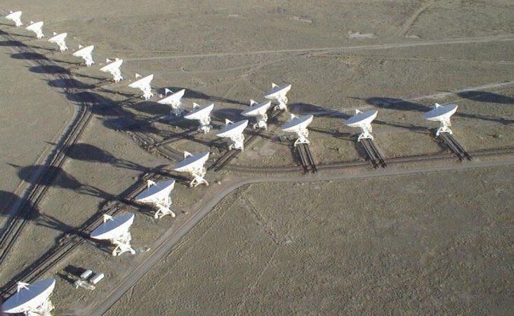
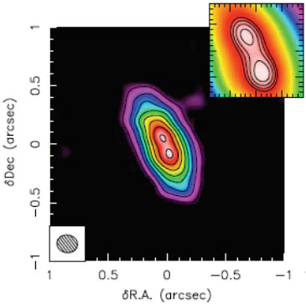
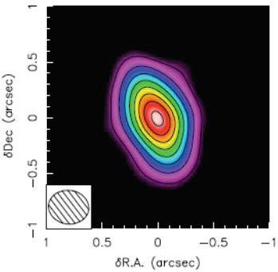
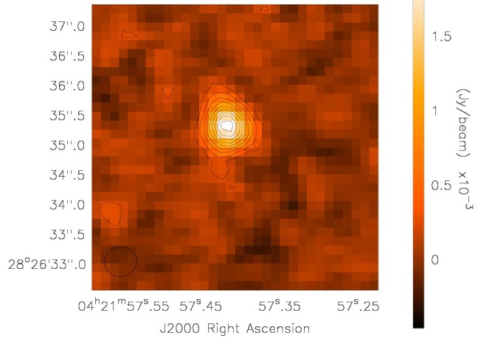
How to constrain the radial variation of dust properties?
CARMA
VLA
High-res observation
Disk around RYTau
High angular resolution observations at 3 different mm-λ of RY Tau
res~0.15’’
(~20 AU)
res~0.3’’
(~40 AU)
CARMA
Isella & al. (2010)
1.3mm
2.8mm
res~0.5’’
(~70 AU)
VLA
new data
6.92mm

Slide 13
How to constrain the disk parameters?
We use χ² fitting procedure (directly on visibility)
1
Choose the grid models (n free-param with a wide range of value)
Free parameter
Σ_{tr} | R_{tr} | γ | a_{0max} | b_{max} | inc | P.A.
Produce disk images
Fourier trasform it and sampled at the (u,v) points corrisponding to the observed samples
Computed the χ² value
2
Costruct the χ² hypercube
(for each λ)
3
Calculate the best fitting model (minimum of the χ² hypercube_sum)

Slide 14
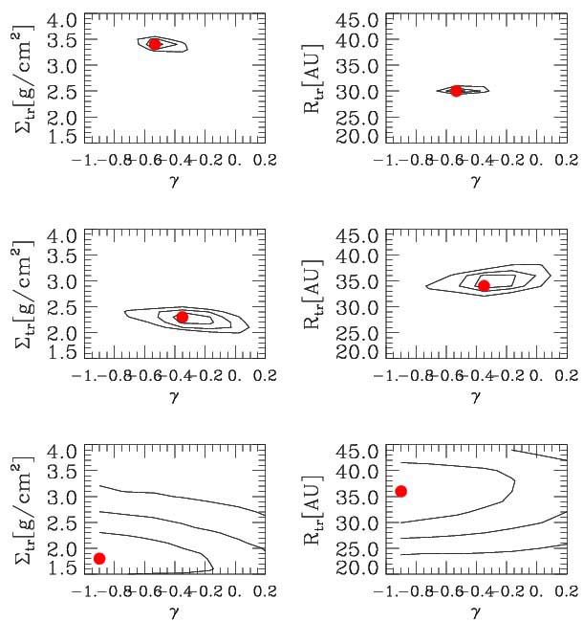
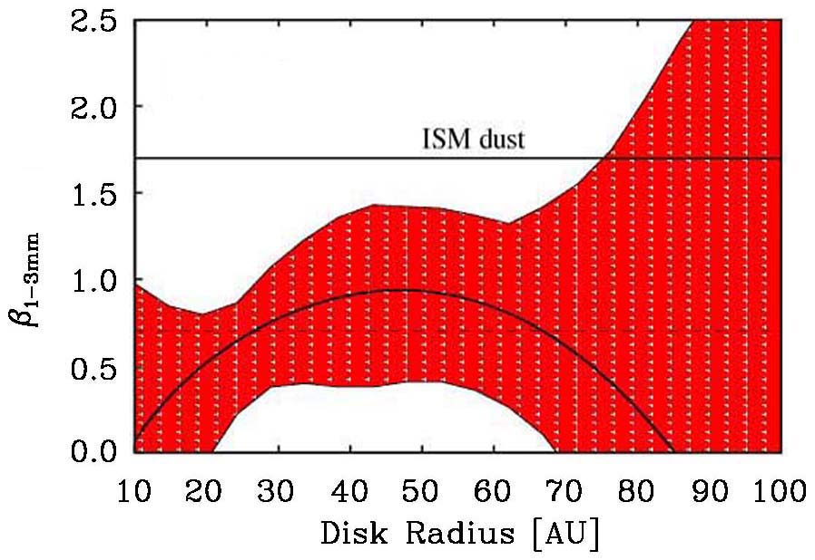
First results
BEST FIT VALUE
R_{tr} = 30 [AU] Σ_{tr} = 3.4 [g/cm^2] γ = -0.53
Compare with Isella & al. 2010
1.3mm
a_{0max}=0.03cm
b_{max}= 0
P.A. = 24°
Inclination = 66°
R_{tr} = 34 [AU] Σ_{tr} = 2.3 [g/cm^2] γ = -0.35
2.8mm
The best fit values we found are ~ in agreement with the Isella result
R_{tr} = 36 [AU] Σ_{tr} = 1.8 [g/cm^2] γ = -0.9
6.92mm
Evidence of radial variation of dust properties
But large error-bars

Slide 15
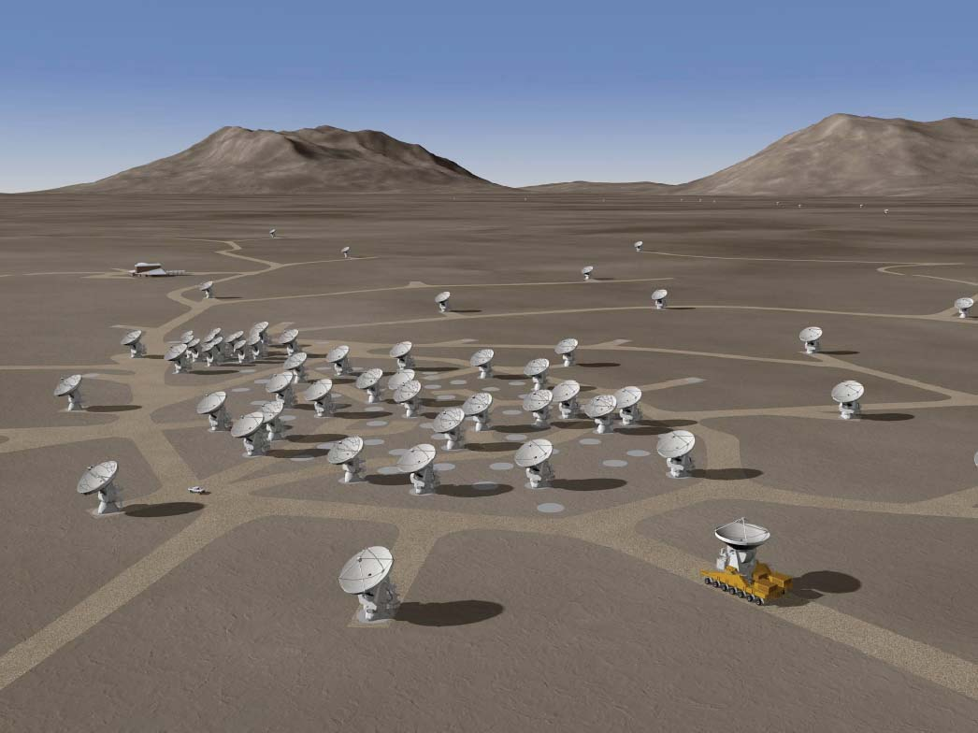
Future prospects
To place more stringent constrains on the radial variation of the dust opacity we need of observations with:
higher angular resolution
higher sensitivity
ALMA
At least 50X12m Antennas
max resolution <0.01’’
at 870 μm
(at near star forming region)
Will be able to resolve structure of few AU
Should be possible detect spiral structure of few AU

Slide 16
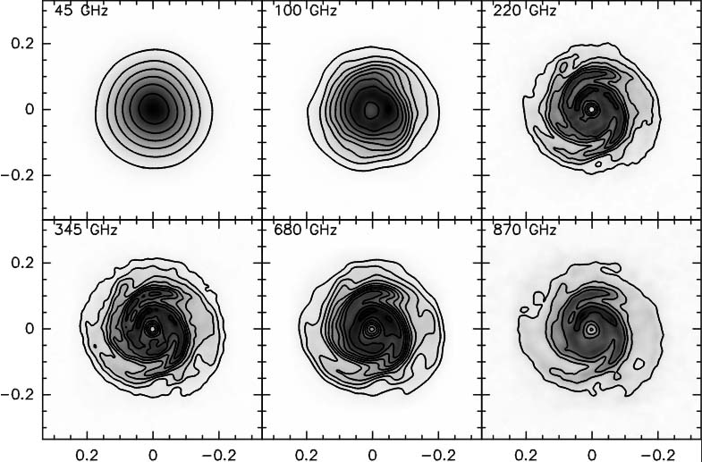
Simulated observations of massive self-graviting circumstellar disk with ALMA
Cossin,Lodato,Testi (2010)
Intensity maps at sub-mm λ from SPH simulation of disk
CASA ALMA simulator
Image maps at that sub-mm λ with various array conf.
Should be possible detect spiral structure of few AU
(Taurus-Auriga star-forming region)

Slide 17
Conclusions
mm spectral slopes indicate presence of mm-size dust grains in
the disk (dust grain growth)
High angular resolution observation show us radial variation of
dust property in circumstellar disk
However
To study the radial variation of the dust properties we need of
observations with higher angular resolution and sensitivity
ALMA will play a crucial role in the next future

Slide 18
E N D

