Slide 1
Radio observations of the massive star forming region G305
YERAC 2011
Luke Hindson
University of Hertfordshire / ATNF
Mark Thompson (Hertfordshire), James Urquhart (ATNF), Ben Davies (Leeds), Simon Clark (Open University), Alessandro Faimali (Hertfordshire)
Notes:
Welcome good morning – Title – Introduce luke hindson 3rd yr phd student

Slide 2
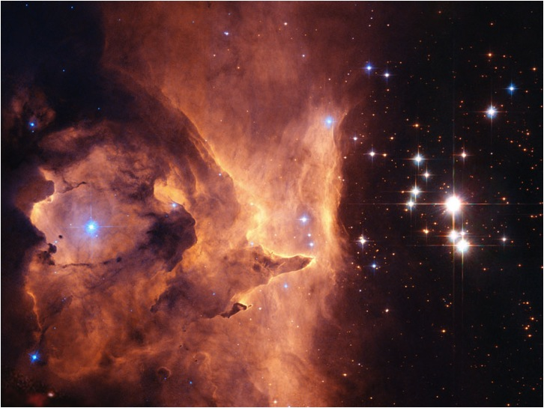
Massive Star Formation
Young Massive Stars
Molecular Material
NGC 6357
Evolved Massive Stars
Pismis 24
Interaction
Notes:
Research concerns Massive stars they have a
Profound effect on GMC in which they form and the wider galactic environment these effects are due to
Ionising radiation from uv photons – mechanical energy via stellar winds – and they introduce chemically processed matter
So are very important to many areas of astronomy.
The image you see here shows an excellent example of a massive star forming region Pismis 24 > 100msun NGC6357 evolved right, young/blue left
Formation, evolution and impact poorly understood
Radio observations allow us to penetrate the opaque dust that surrounds these regions and observe the embedded ongoing star formation as well as the molecular environment

Slide 3
Project Aims
Disentangle the star formation mechanisms and history of the giant molecular cloud G305.
What is the role of stellar feedback?
How do massive stars propagate?
What are the statistical life times of each stage of massive star evolution?
Constrain theoretical models.
Notes:
What I am going to do / doing
Know whre all stars and when they formed
Want to know whats going on
What are initial conditions for the formation of massive stars and triggering
A number of surveys passing over this is like a mini survey

Slide 4
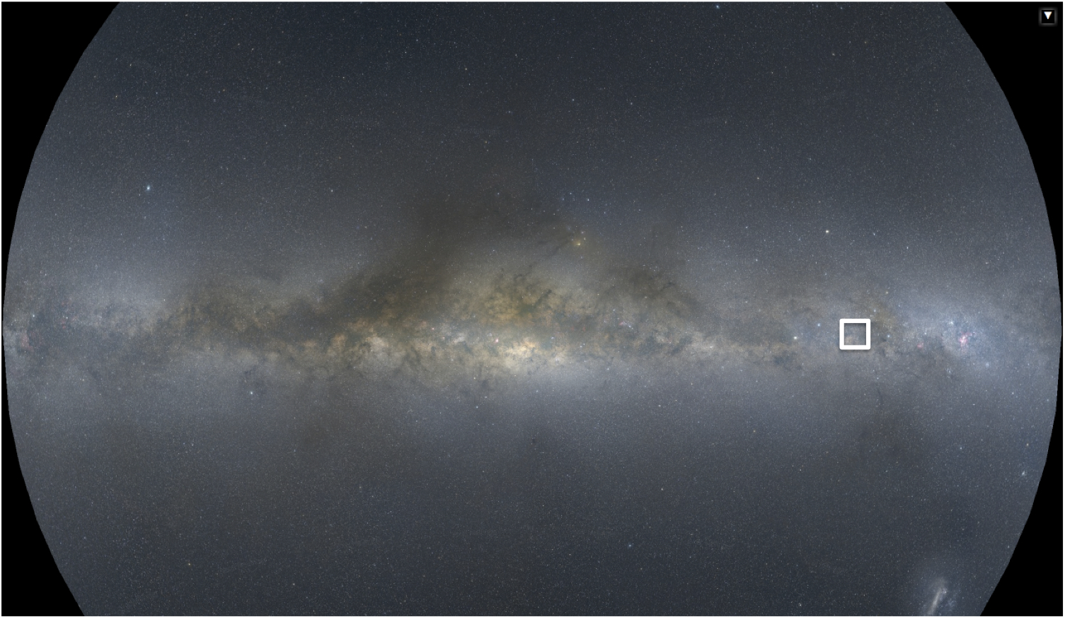
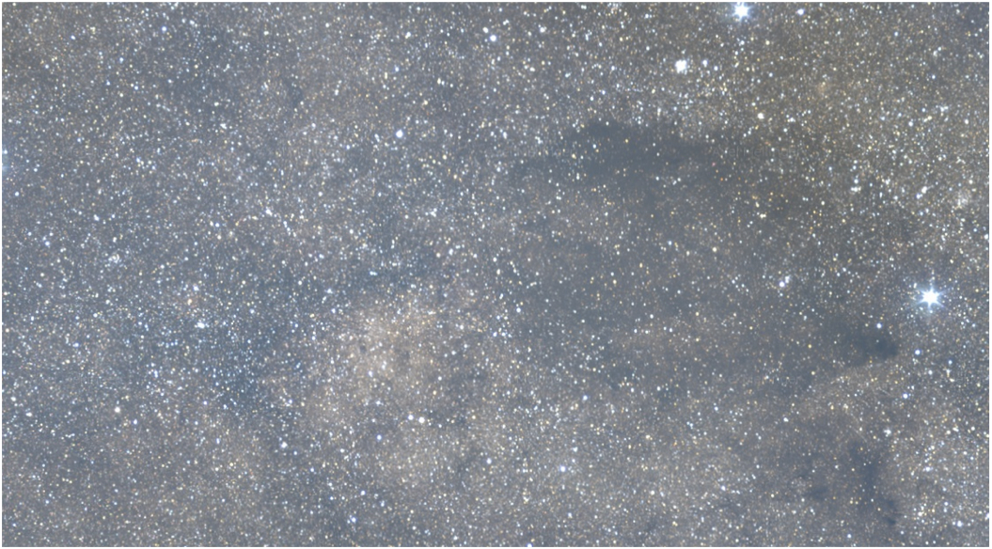
G305
Mellinger 2009, http://home.arcor-online.de/axel.mellinger/

Slide 5
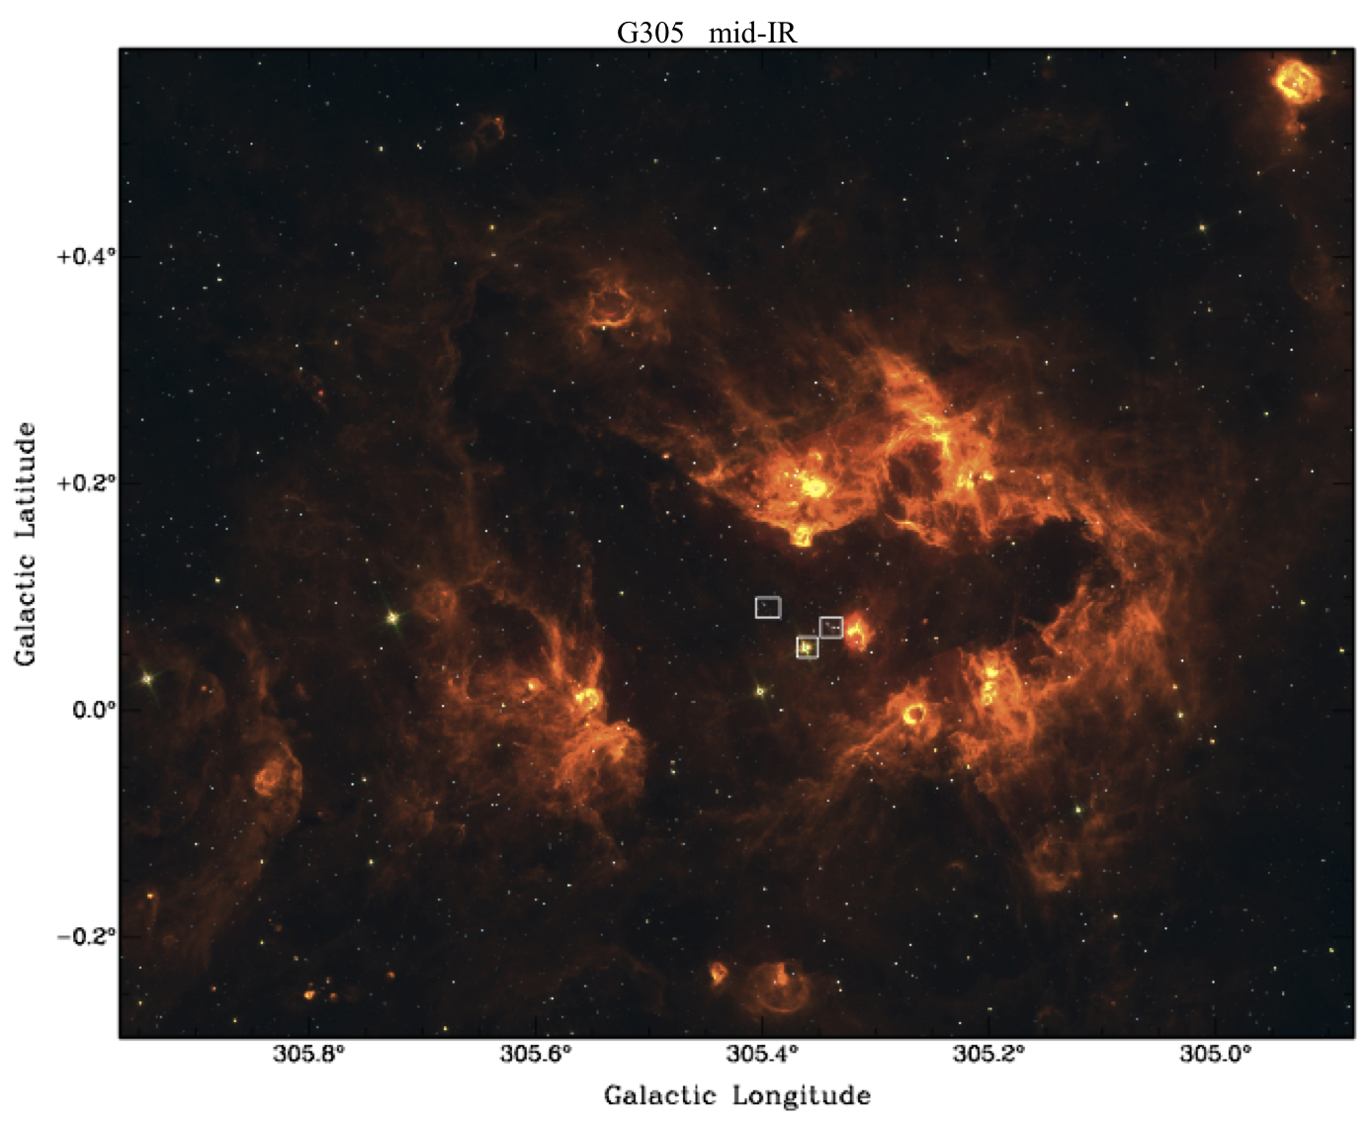
Notes:
3 colour Glimpse image – red emission - Dust – describe region 4kpc etc – why study G305 – massive stars at all evolutionary stages/close sup-parsec/new instruments allowing wide field imaging
Image of G305 at optical wavelength and at radio for comparison

Slide 6
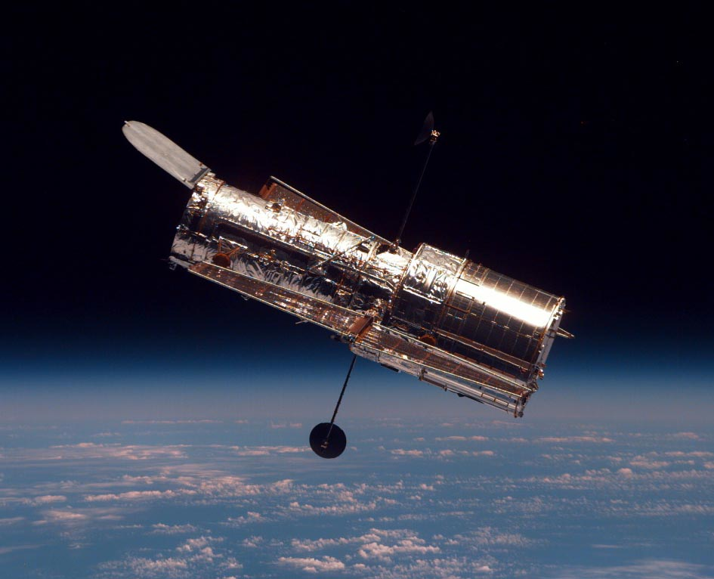
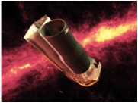
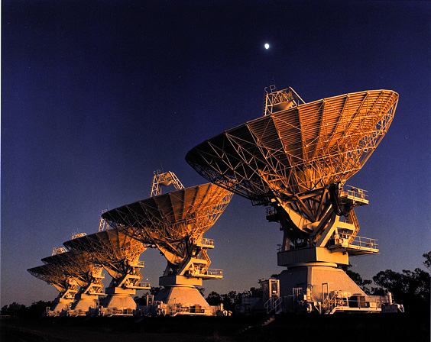
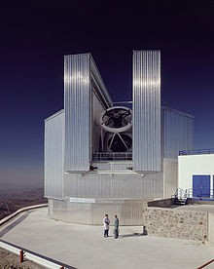
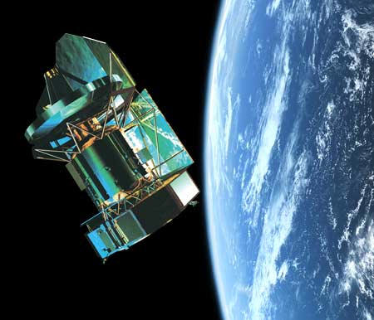
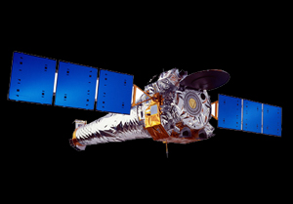
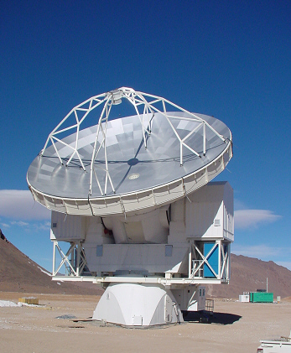
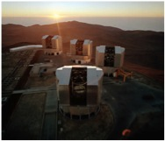
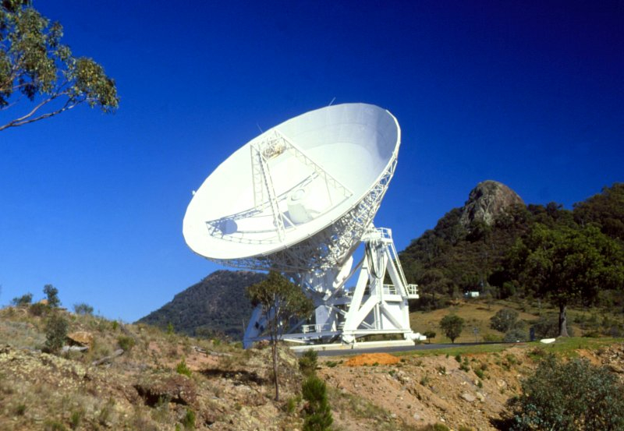
HST
Australia Telescope Compact Array
(ATCA)
Spitzer
NTT
Chandra
Herschel
APEX
Mopra
VLT
Notes:
The solution
Simulations and observations and high resolution and sensitivity of multiple wavelengths the whole galactic plane
Impractical – Will be done in the future – for now we provide a case study by observing a single GMC
Report on my observations using MOPRA and ATCA
Differet pros,cons of each telescope quickly go over each and what they show
Mopra large regions global properties large scale
ATCA ionised gas >freq deust 3mm molecular lines
NAMES, Apex dust mass
HST spectral classes ionise sources
Spitzer mid ir
Herschel far ir sub mm
VLT
NTT
Cover the whole
Chandra protostars evolved stellar sources

Slide 7
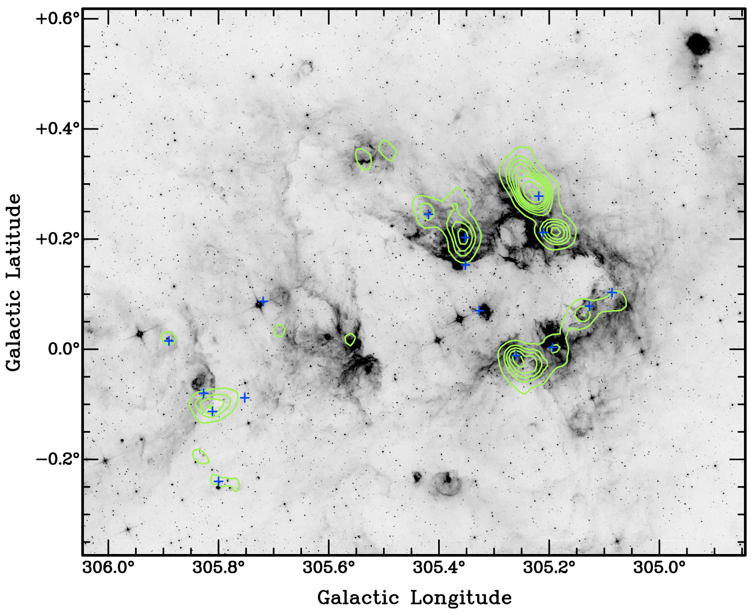
Mopra 12 mm Observations
NH₃ (green contours)
Reveals dense gas
Reveals the reservoir for future star formation
Pathfinder for high resolution follow up of hot molecular cores
H₂O masers (blue crosses)
Trace regions of ongoing star formation
Very bright and variable
Hindson et al. 2010
Notes:
Future star formation
Describe observations – Mopra/2009/OTF/2’/60mk - Objectives – search for dense molecular gas traced by ammonia/locate star formation via the presence of water masers/determine the physical properties/estimate the reservoir for future star formation/ - Describe results – Number of large massive clouds/less to the east/ masers embedded/ >10^5msun- Implications –from these initial observations we can tell there is ongoing SF within dense material/sufficient material to create many stars in the future
Reference paper

Slide 8
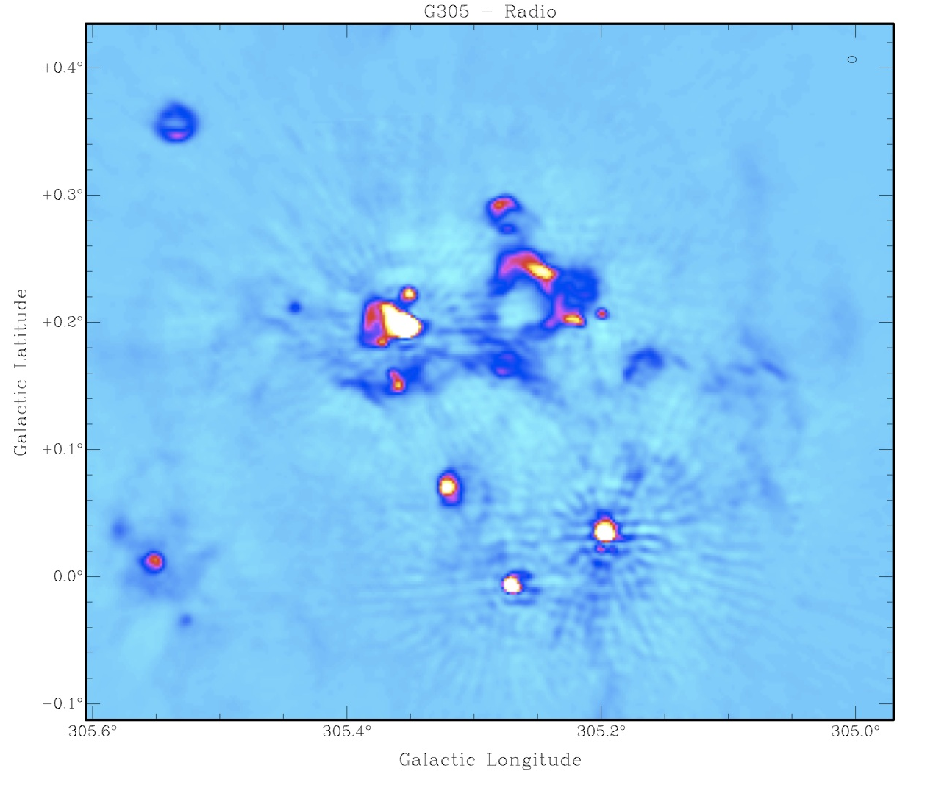
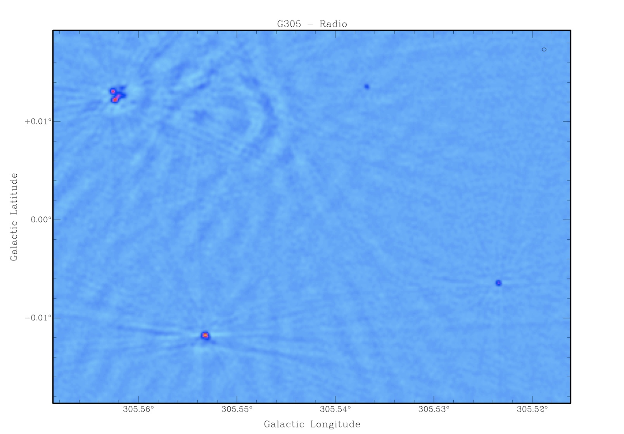
ATCA 3 & 6 cm Observations

Slide 9
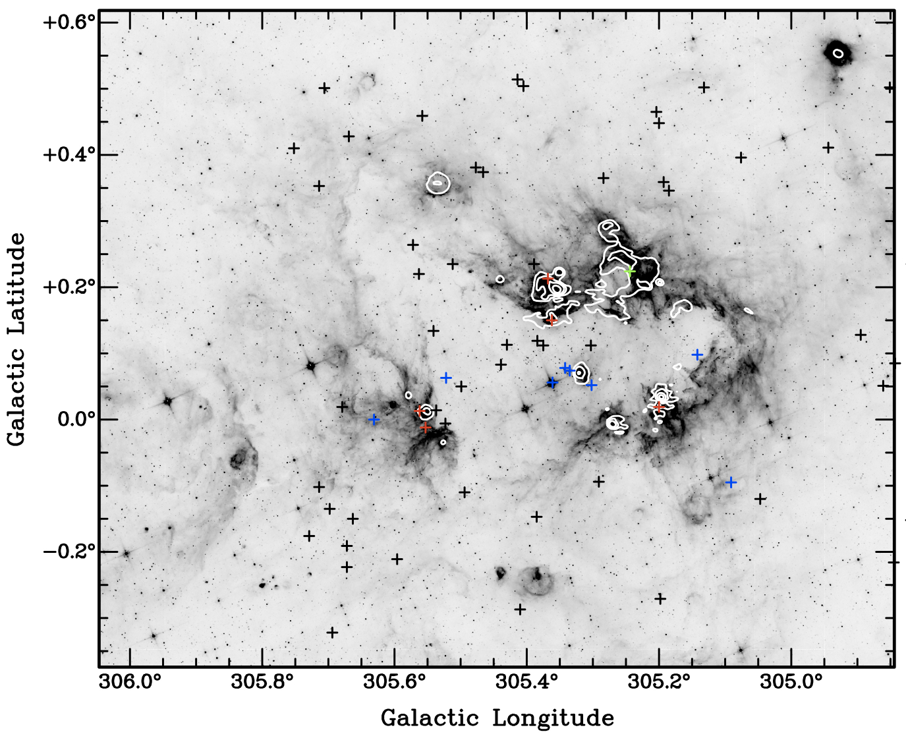
ATCA 3 & 6 cm Observations
UC HII’s (red crosses)
Direct indicator of massive star formation
Young (<10⁵ yrs)
Determine properties
Stellar Sources (blue crosses)
Ionised winds
Non-thermal emission
Background (black crosses)
Radio Galaxies
Large scale ionised regions (white contours)
Older HII regions
Ionised boundary layer
Interaction region
Hindson et al. 2011 (submitted)
Wilson et al. 2011
Notes:
Recent Massive star formation
Describe Observations – 5.5 8.8 GHz/1”/0.1mJy/6array configs/357 points/difficult to reduce - Objectives – image ionised environments/ locate UCHII/how are massive stars effecting the region IBL/ results – multiscale/largescale/70 smallscale/determine nature - implications – lots of massive sf/confined to cavity periphery/UCHII on borders of HII
Fov – borders
Reference cabb

Slide 10
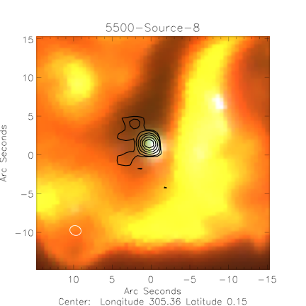
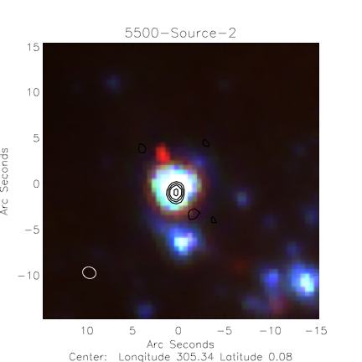
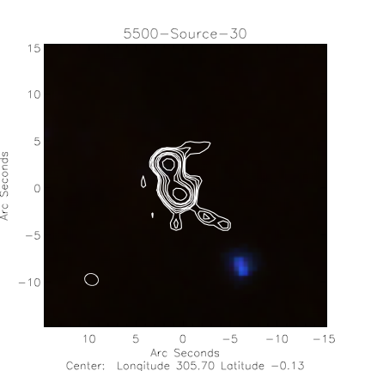
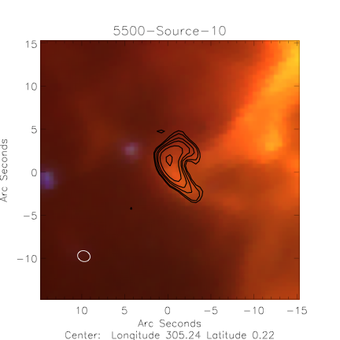
UC HII region
Stellar Wind
Background Radio Galaxy
Bright-rimmed Cloud
Notes:
Match to IR data to determine nature
UCHII = in IR dust reprocessed UV radiation
Ref in prep

Slide 11
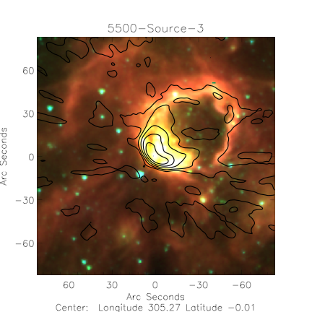
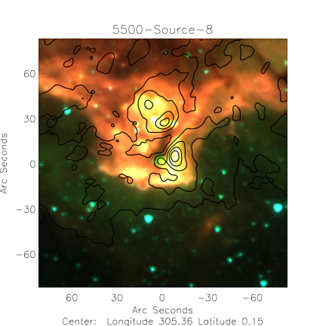
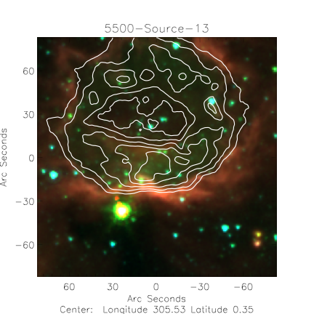
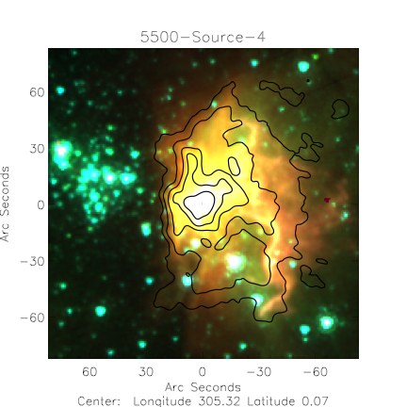
Notes:
In the future I will examine the large scale emission
Compact HII regions
IBL
shells

Slide 12
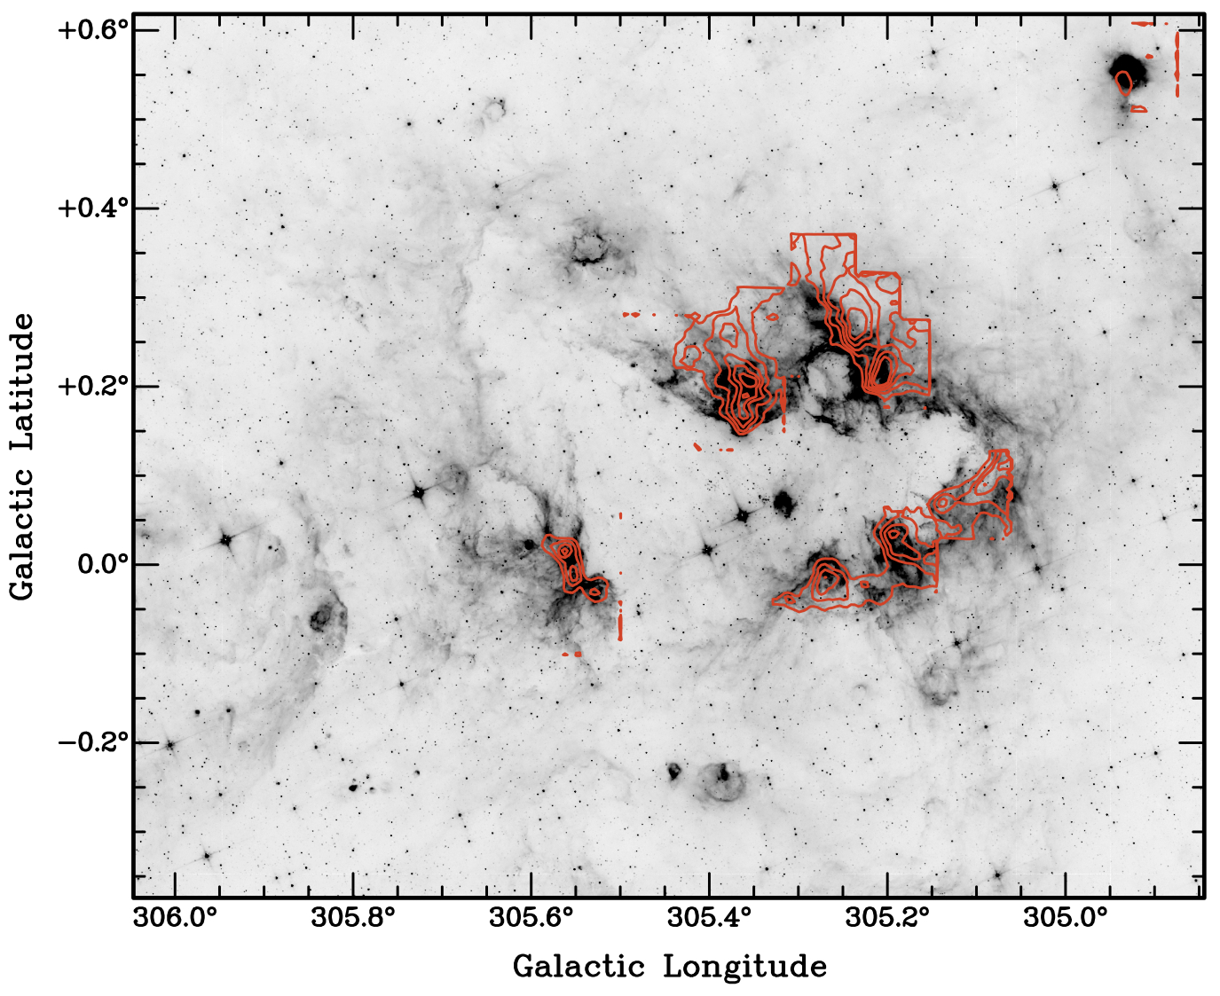
Mopra 3 mm Observations
¹²CO (red contours)
¹²CO ¹³CO C¹⁸O
Trace molecular gas
Kinematics (outflows)
Interaction
Notes:
CO observations
Describe – Objectives – Results - Implications

Slide 13
Summary
We are in the process of analysing a large and high quality multi-wavelength data set.
Initial radio results have revealed
Large reservoir for future star formation (6×10⁵ M).
Massive stars are propagating outwards into the molecular material forming what appears to be a classical OB association.
SFR ≈ 0.01 Myr⁻¹ - SFE ≈ 2×10⁻³ .
Star formation appears enhanced around HII regions.
The degree to which massive stars in G305 are effecting their surroundings is still unclear.
Notes:
What is the main point I want them to take away

