Slide 1
Low-frequency radio maps for the REXCESS cluster sample
S.R. Heidenreich, University of Southampton
In collaboration with
J.H. Croston, University of Southampton;
H. Böhringer, MPE Garching; G.Pratt, CEA-Saclay; S. Raychaudhury , University of Birmingham; Melanie Johnston-Hollitt, Victoria University of Wellington

Slide 2
Motivation
The evolution of the baryonic component of the Universe is one of the main outstandung challenges of extragalactic astronomy
Recent X-ray observations: Dark matter distribution in good agreement with predictions but substantial discrepancies between observed cluster gas porperties and predictions from simulations
Clusters are underluminous in X-ray for their mass, seems to be due to an excess in gas entropy that extends to outer regions of the cluster
Notes:
Simulations do not contain non-gravitaional physics
Image of simulation

Slide 3
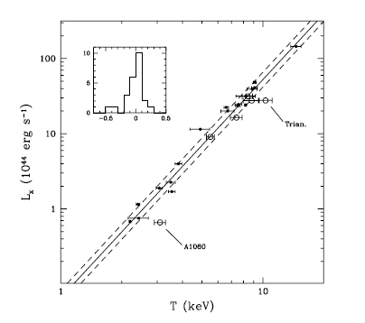
Motivation
Excess entropy thought to result from radiative cooling and heating from radio loud AGN
Cluster surveys at high redshift rely on scaling relations between cluster mass and observables, that depend on cluster gas properties
→ Essential to understand the processes that cause the observed scaling relations to differ from predictions and understand scatter in these relations and how they evolve with redshift
Arnaud& Evrard 1999
Notes:
Plot x-ray luminosity vs Temp
Power low slope of 2.8

Slide 4
Aims
To complete mapping of the entire REXCESS sample at 610 MHz and 240 MHz.
To characterize the radio-loud AGN population of the clusters by optically identifying cluster radio sources, measuring luminosities, making morphological classifications, and producing spectral index maps.
To identify radio relic and halo sources and measure their properties.
To determine the equipartition energy content of the cluster-centre radio galaxies, and to use radio scaling laws (e.g. Birzan et al. 2008, ApJ 686 859) to investigate their energetic impact.
To investigate the relations between AGN properties and global cluster characteristics (e.g. X-ray luminosity, mass, gas mass fraction, dynamical state, temperature, pressure and entropy distribution, BCG properties) determined from our multi-wavelength data.
To investigate the effect of radio-loud AGN on cluster scaling relations (e.g. luminosity-temperature, entropy-temperature and M_{gas}-temperature) and the effect of both central cluster AGN and non-central AGN on cluster gas properties.

Slide 5
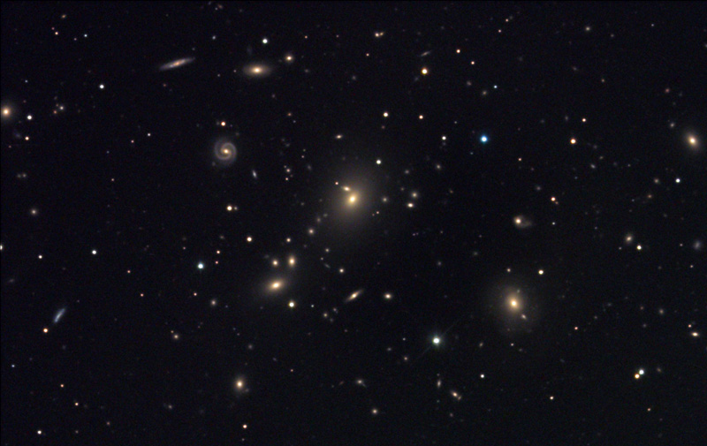
Galaxy clusters
10 -15 % baryonic matter ( 8-10 % hot gas, ~1% stars, rest cold gas & dust)
85-90% dark matter
Hundreds of member galaxies
Total mass >10¹⁴ M_{sun}
Contain old, massive ellipticals in the center and mainly late-type galaxies in the outer regions
Notes:
Evolution:,via mergers, induced starbursts, stripping of gas and the prevention of its replenishment

Slide 6
REXCESS Cluster Sample
33 nearby (z < 0.2)galaxy clusters
Unbiased by dynamical state
Fully samples cluster luminosity function
Observed in X-ray, optical, SZ and radio wavelength
→ Determination of distribution of properties for local cluster population as a whole
Notes:
Unbiased by dynamical state:
There are relaxed clusters,which are the main ones studied in the past and there are relatively young merging ones
The special and unique thing about the REXCESS sample is, that it doesn‘t care about these dynimical states.
This makes it representative of the local cluster population
Other samples usually use mainly the relaxed ones.
The REXCESS sample was selected from the flux-limited REFLEX catalog (Böhringer 2004)

Slide 7
All REXCESS clusters in X-ray
Böhringer et al. 2007

Slide 8
A relaxed cluster
Böhringer et al. 2007

Slide 9
A merging cluster
Böhringer et al. 2007

Slide 10
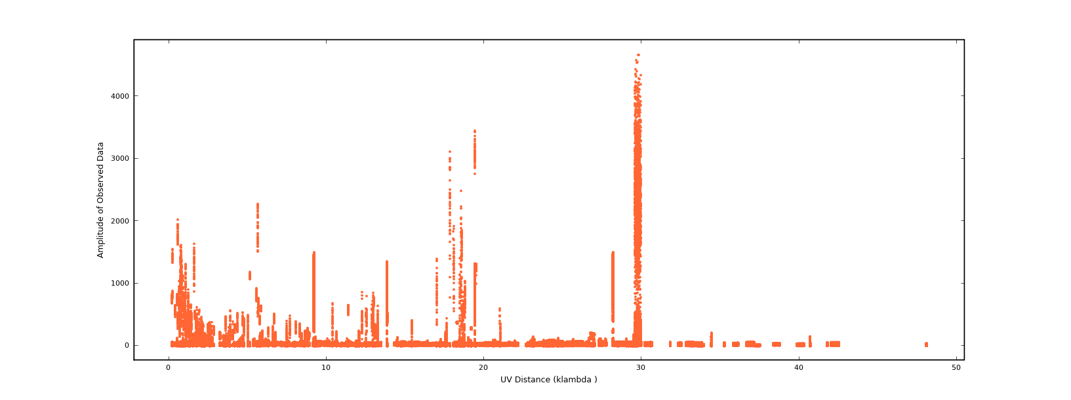
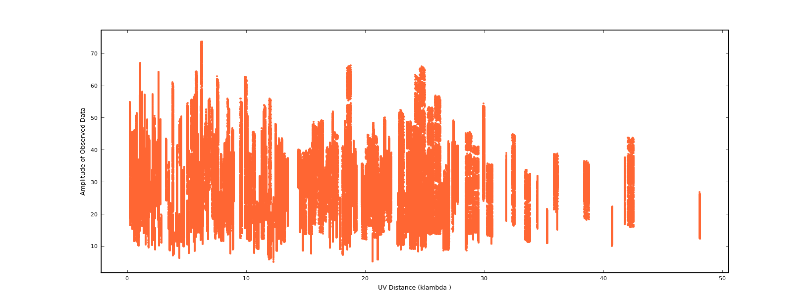
RFI flagging - a challenge in low frequency data
Before flagging
After flagging

Slide 11
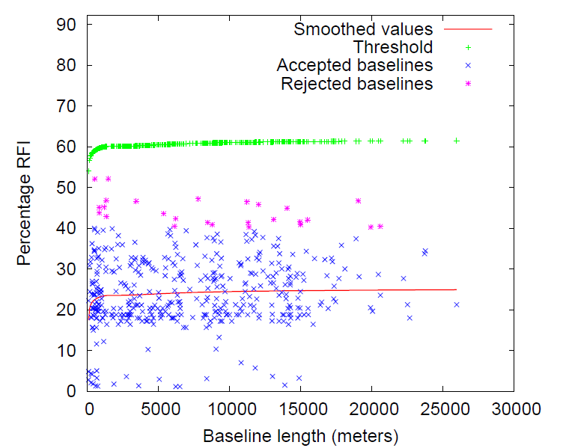
CASA and AOFlagger
CASA Script in combination with AO-Flagger
AO-Flagger developed for LOFAR detects rfi and bad baselines
Another challenge is the imaging, where widefield has to be used

Slide 12
Calibration Process

Slide 13
Summary of all mapped clusters
Data reduction for 9/28 clusters is complete
7/9 show an associated radio sourde
4/7 show source at position of central peak in X-ray
Clusters are nicely distributed over whole X-ray luminosity, and X-ray temperature range

Slide 14
Luminosity-Temperature relation
Red stars:
Already mapped clusters
Black stars:
Currently unmapped clusters, but data available
Black line: fit
Grey lines: error on fit
X-ray data from Pratt et al. 2008
Notes:
Clusters selected are spaced over whole range
Prediction from gravity
L ~ T²

Slide 15
Luminosity vs. redshift
red stars:
Already mapped clusters
Black stars:
Currently unmapped clusters, but data available
X-ray data from Pratt et al. 2008
Redshifts from Böhringer et al. 2007
Notes:
Mapped ones spread nicely over redshift range

Slide 16
L_{X-ray} vs. T_{X-ray} bright and faint sources
Red stars: faint radio sources luminosity density < 10²⁵ W Hz⁻¹
Blue stars:
bright radio sources luminosity density > 10²⁵ W Hz⁻¹
Notes:
No corellation for faint sources
All bright ones are above the fitted line

Slide 17
X-ray luminosity vs. Radio luminosity extended and point sources
Blue stars: point-like mapped clusters
Red stars:
Extended mapped cluster
Notes:
Maybe hint that pointlike are more down and right than extended
-> need more data to verify

Slide 18
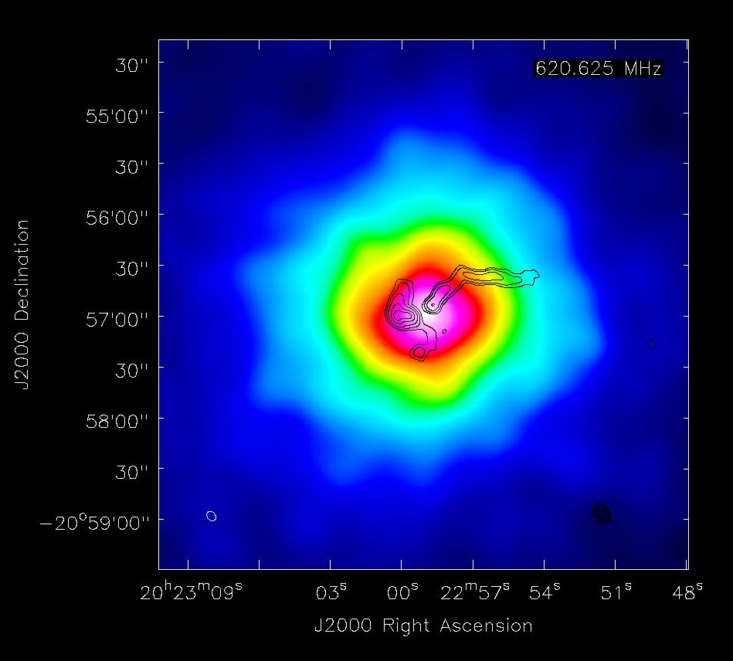
RXCJ0006 and RXCJ2023
Notes:
Both have emission from the peak or close to the peak of the x-ray
RXCJ0006 is a dirsturbed extended cluster
RXCJ 2023 is a disturbed cluster, but with a radio source close to the central peak of the x-ray

Slide 19
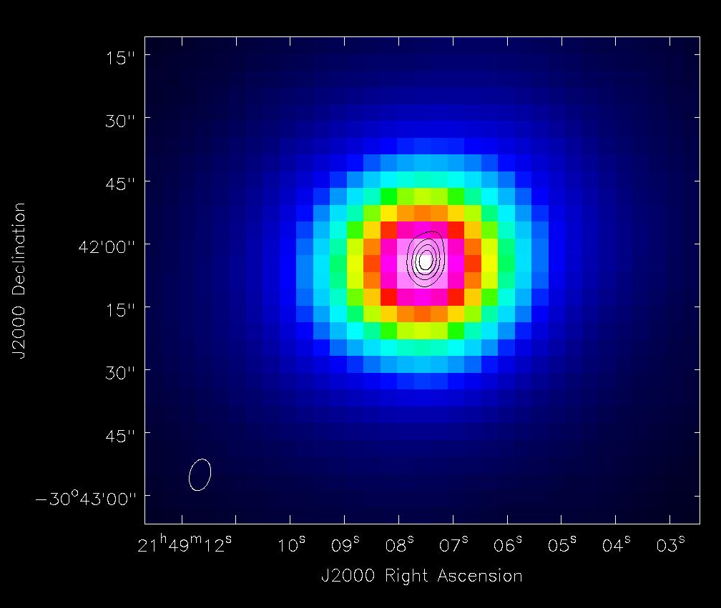
RXCJ2234 and RXCJ2149
Notes:
RXCJ2149 x-ray and radio peak at same place and it is the only CC cluster mapped so far.
RXCJ2234 seems to peak where the x-ray is less intense

Slide 20
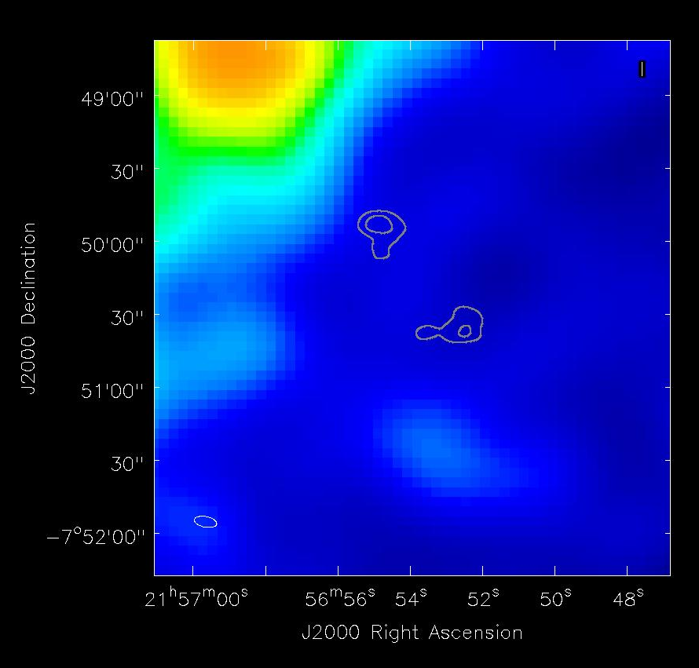
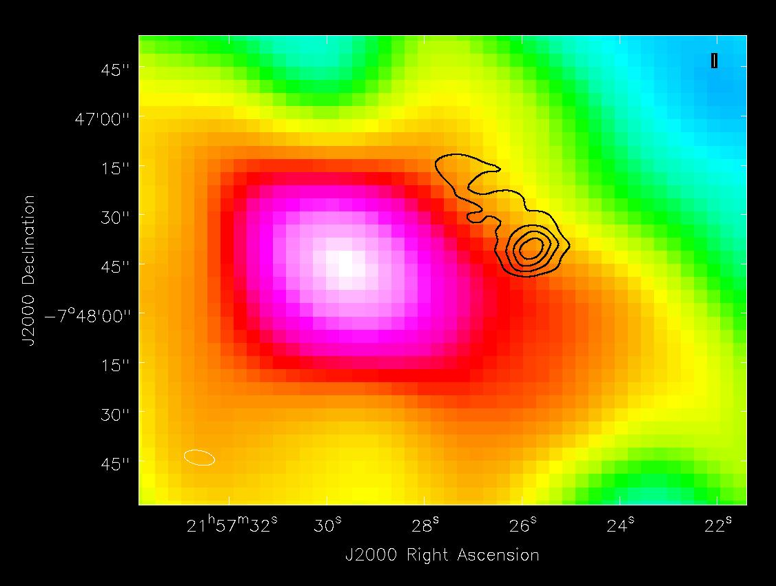
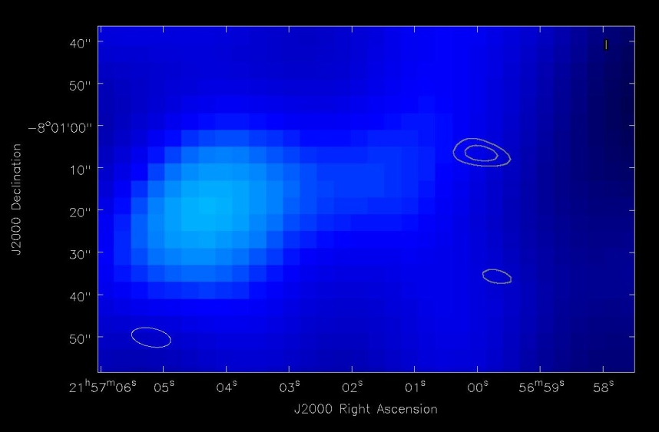
RXCJ2157

Slide 21
Future work
Finish mapping of REXCESS sample
Make maps using the 240 MHz data for spectral information, estimate ages and energetics.
Compare their X-ray and optical properties and scaling laws
Use REXCESS sample as baseline to extend it to higher redshift with GMRT and LOFAR to investigate the evolution of cluster radio-loud AGN populations and their effect on scaling relations
Use LOFAR to investigate presence of diffuse radio emission associated with previous cycles of AGN activity
Notes:
Properties: gas density, temperature, pressure, entropy profiles, cluster dynamical state, cluster mass, cluster mass profiles, brightest cluster galaxy properties, cooling signatures

Slide 22
The End

