Slide 1
Determining broad-band spectra of radio galaxies with the EVLA
Jeremy Harwood YERAC 2011
Background Image courtesy of NASA/CXC/CfA/R.Kraft et al.; MPIfR/ESO/APEX/A. Weiss et al.; ESO/WFI

Slide 2
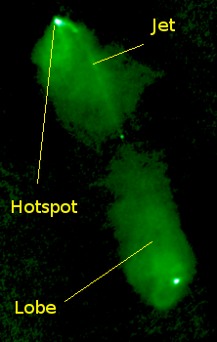
What are radio galaxies?
Type of active galaxy
Fanaroff and Riley class I
Fanaroff and Riley class II
Quasars (in unified models)
Definition of galaxy class is subjective
Predominantly found in massive ellipticals
Radio features are non-thermal sources
The shape of their SED’s can often give key insights into the underlying physics of the source

Slide 3
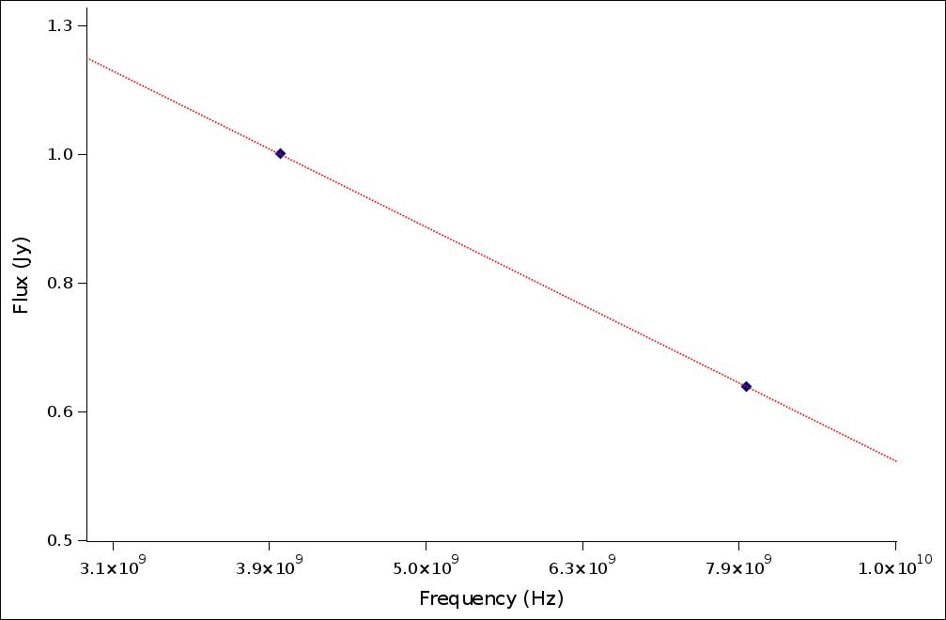
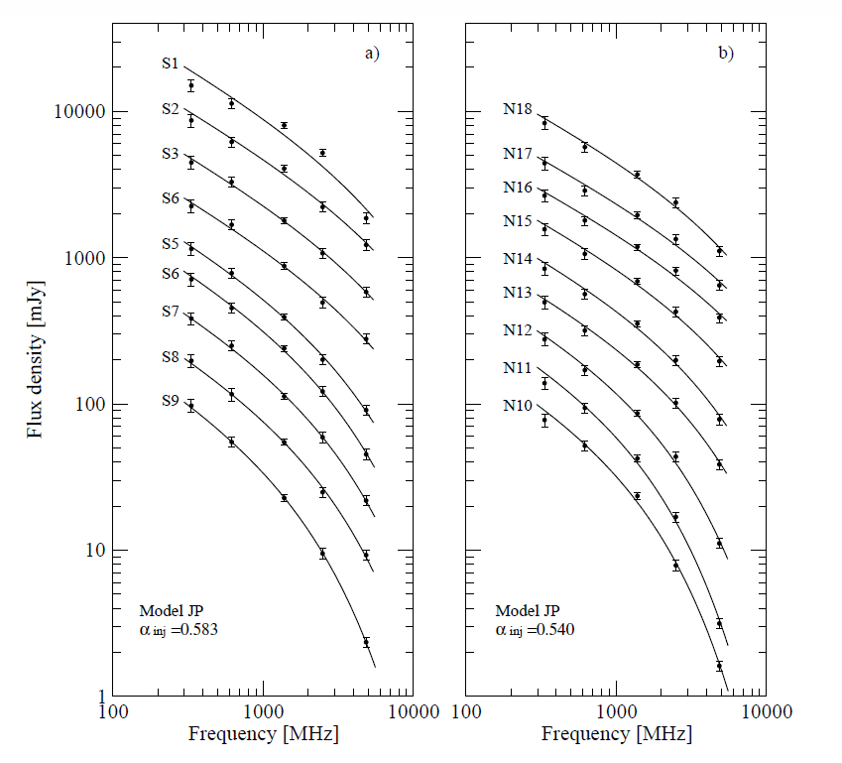
Previous generation of radio telescopes
Poor sampling in frequency space, a few GHz frequencies at best
Narrow band observations (50 MHz with the VLA)
Producing detailed SED’s previously required large amounts of observing time
J1548–3216 (Machalski et al. 2010)

Slide 4
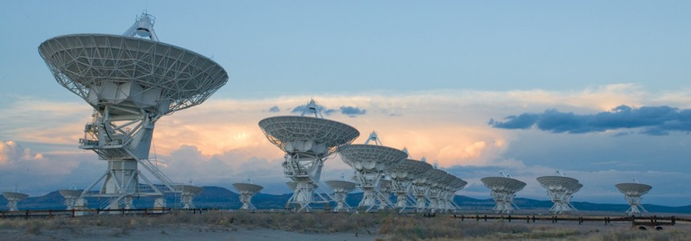
The next generation of radio telescopes
EVLA once fully upgraded will not suffer these problems
128 MHz bandwidth currently; 8 GHz when fully upgraded
Develop methods of analysis using this new capability
Determine the importance of spectral ageing in FR-II galaxies
Image courtesy of NRAO/AUI and NRAO

Slide 5
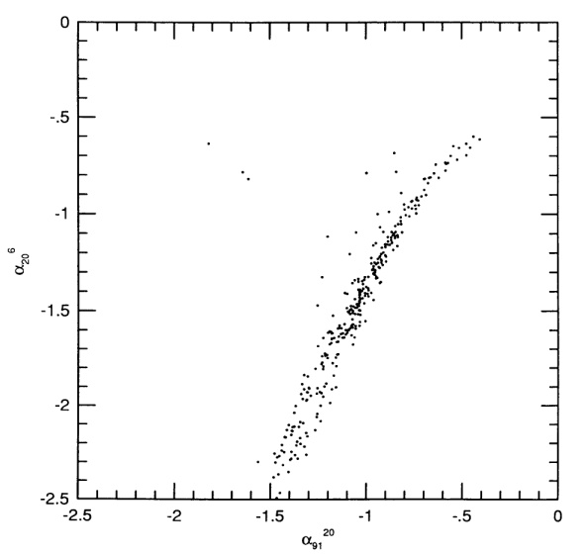
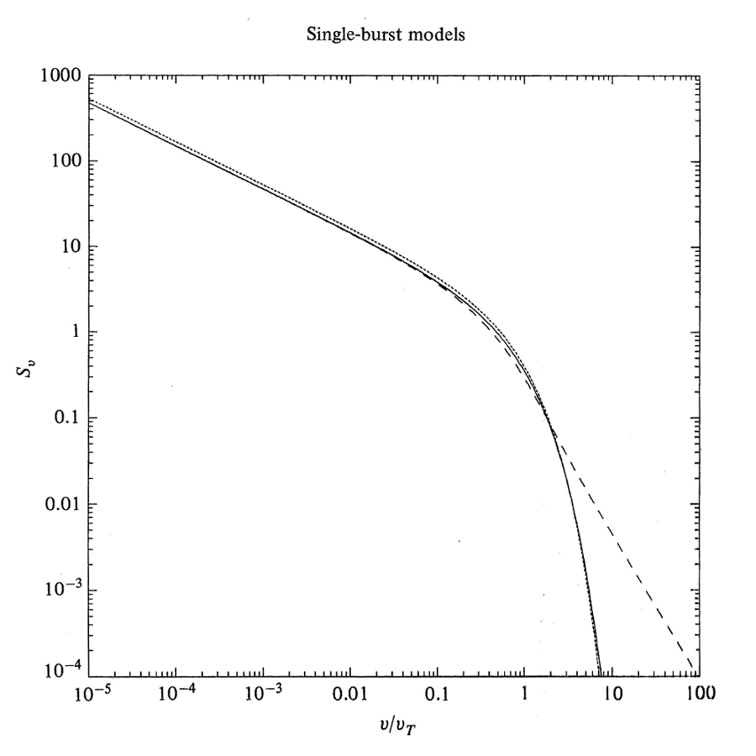
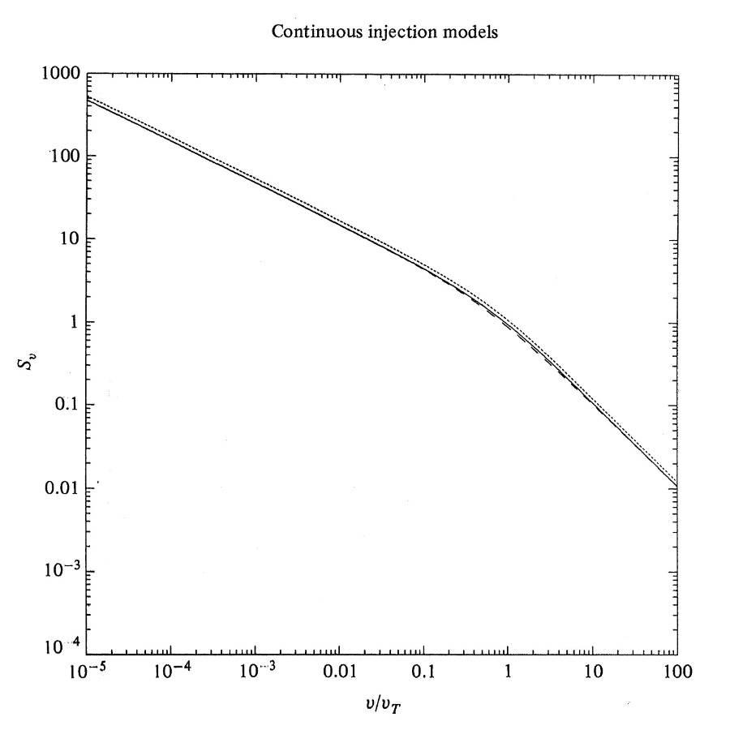
Spectral ageing in the radio lobes of FR-II galaxies
What is spectral ageing?
Preferential cooling of higher energy particles -
Break frequency dependant on time and magnetic field -
Can be used to determine the age of a region
Previously unable to produce detailed SED’s to directly test its importance
Indirect arguments using colour-colour diagrams needed
Katz-Stone et al. 1993
Hughes 1991 “Beams and Jets in Astrophysics”

Slide 6
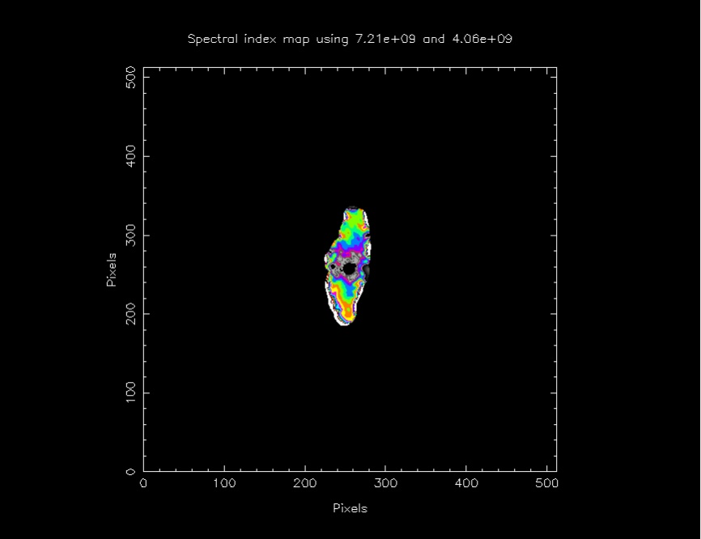
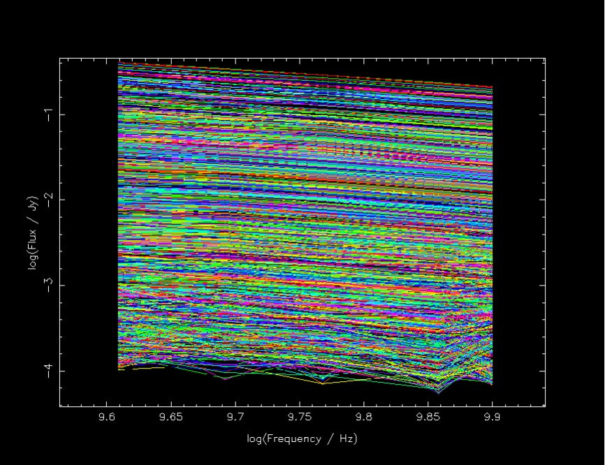
Latest results
Emission intensity maps
High resolution spectral mapping
Full map spectral profiling
Detailed spectra of specific emission regions

Slide 7
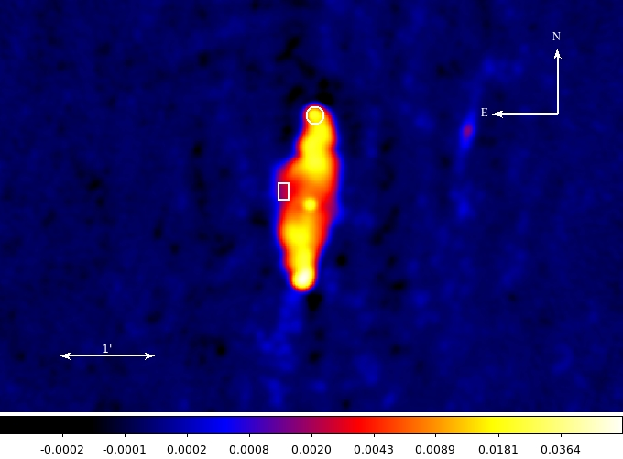
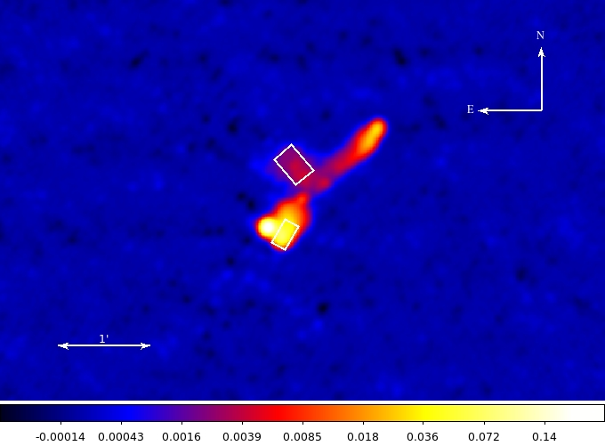
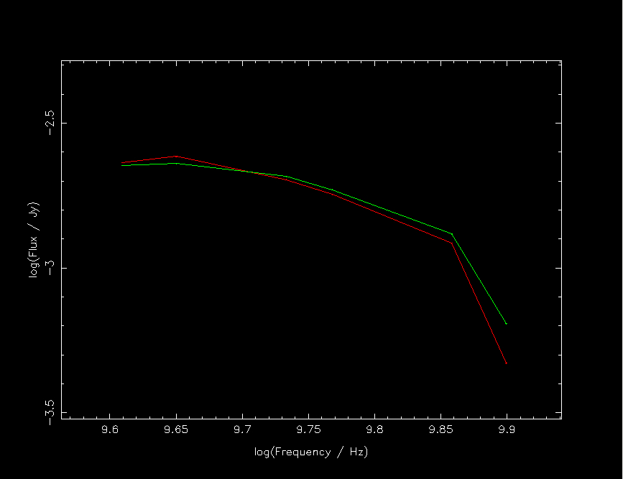
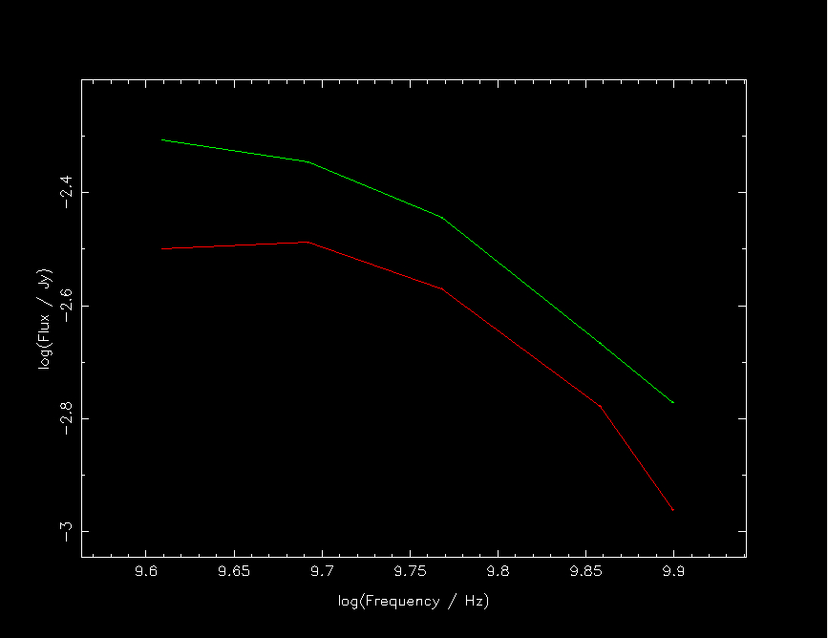
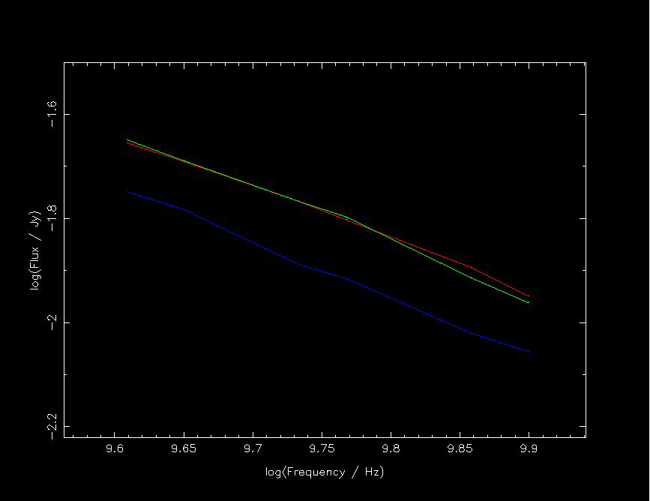
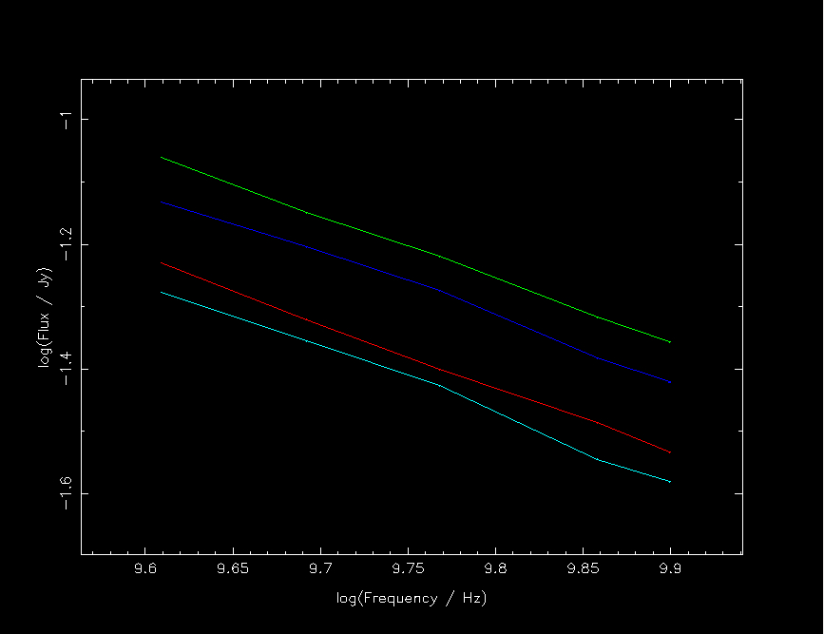
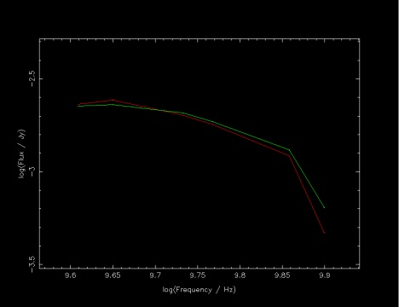
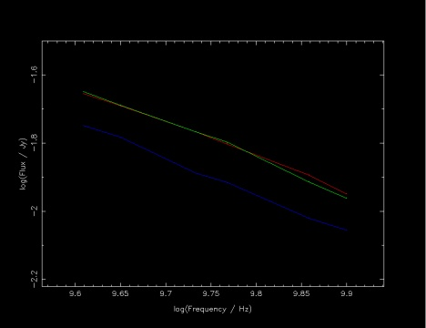
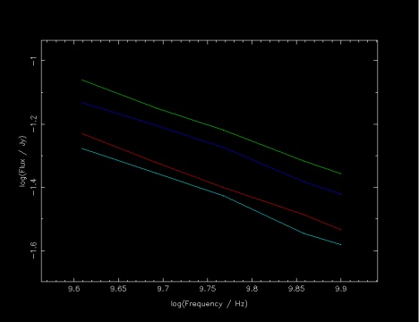
Latest Results

Slide 8
What’s next?
Fitting of spectral ageing models
Colour-colour plots for direct comparison to previous works
e-Merlin
Extragalactic jets legacy project
Jet dynamics
3 dimensional structure of powerful jets
Magnetic field configuration
Particle acceleration in jets and hotspots
LOFAR
Low energy observations of powerful radio galaxies
Comparison to inverse-Compton observations

