Slide 1
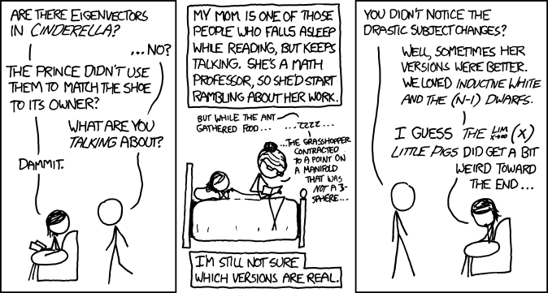
xkcd
Xkcd.com

Slide 2
Section 3 Recap
Angular momentum commutators:
[J_{x}, J_{y}] = iħJ_{z} etc
Total ang. Mom. Operator: J ²= J_{x}²+ J_{y}² +J_{z}²
Ladder operators:
J₊ = J_{x} + i J_{y} , J₊| j, m⟩ = c₊( j, m) | j, m +1⟩ (=0 if m = j)
J₋ = J_{x} − i J_{y} , J₋| j, m⟩ = c₋( j, m) | j, m −1⟩ (=0 if m = −j)
c ±( j, m) = √[ j (j +1)−m (m ±1)]ħ
Eigenvalues
J ²: j ( j +1)ħ ², j integer or half-integer
J_{z}: m ħ, (−j ≤ m ≤ j ) in steps of 1
Matrix elements: raising (lowering) only non-zero on upper (lower) off-diagonal
Eigenvector ordering convention for angular momentum: First eigenvector is largest angular momentum (m = j ).

Slide 3
Section 3 Recap
Direct products
Of vector spaces, of the vectors in them, of operators operating on them
Operator on first space (A₁) corresponds to A₁⊗I on direct product space.
Orbital angular momentum acts on (θ,φ), factor space of 3-D space (r, θ, φ ).
Extra constraint on total angular momentum quantum number ℓ: integer, not half-integer
Spin angular momentum acts on its own vector space, independent of 3-D wave function.
Fundamental particles have definite total spin S ²: never changes.
Spin-half: 2-D vector space:
Spin in any one direction is superposition of spin up & spin down along any other direction
Every superposition corresponds to definite spin in some direction or other.
Pauli spin matrices (Neat algebraic properties)

Slide 4
Section 3 Recap
2π rotation of spin-half particle reverses sign of wave function: need 4π rotation to get back to original.
Magnetic resonance example (Rabi precession): spin precession in a fixed field, modulated by rotating field.
Addition of angular momentum
Work in direct product space of components being summed
J = |j₁+j₂| to |j₁−j₂|
Triplet and singlet states (sum of two spin-halfs)
Find Clebsch-Gordan coefficients: amplitude of total angular momentum eigenstates |J, M ⟩ in terms of the simple direct products of component ang. mom. states, |j₁,m₁ ⟩|j₂,m₂ ⟩:
CG Coeffs = 0 unless M = m₁+m₂
Stretched states:

