Slide 1
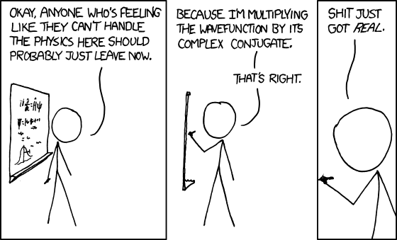
xkcd
xkcd.com

Slide 2
Section 2 Recap
Principle of Superposition: quantum states show interference and require both an amplitude and a phase for the parts
Superposition applies in time as well as space
For any observable, measured values come from a particular set of possibilities (sometimes quantised). Some states (eigenstates) always give a definite value (and therefore are mutually exclusive).
  Model as an orthonormal set of basis vectors.
Model physical states as normalised vectors
  Can be expanded in terms of any convenient set of eigenstates.
Measurements on systems in a definite quantum state (not an eigenstate) yield random results with definite probabilties for each.
  Represent the probabilities of modulus-squared of coordinates |c_{i}|² for the corresponding eigenstates in the eigenbasis of the observable.
Some features of the mathematical formalism (e.g. overall phase of the state vector) don’t correspond to anything physical.

Slide 3
Section 2 Recap
Change with time is represented by a linear, unitary time evolution operator, U(t₀,t)
  Unless interrupted by a measurement
  U → I as the time interval t₀−t → 0.
From U we derive Hamiltonian operator, H, and the (time-dependent) Schrödinger Equation
  For a closed system U = exp[−iHt / ħ ]
Measurements cause apparently discontinuous change in the state vector (“collapse of the wave function”). After an ideal measurement yielding result a_{i} , state is in corresponding eigenstate |a_{i} ⟩
  Best way of preparing systems in given quantum state is measurement + selection of required state.
Hamiltonian for a particle in a field is H = −μ.B = −γ S.B

